Slide 1
Presentation
On
System Requirement Specifications
Of
Automatic Time Table Generator
Presented By:
Syed Shamikh Iqbal
(15MCA06)
Pragati Varshney
(15MCA07)

Slide 2
Contents
Introduction
Review of Literature
UML Diagrams
Feasibility Study
System Requirements
Gantt Chart

Slide 3
Introduction
The traditional hand operated method of time table is very time consuming and usually ends up with various clashes.
Scheduling even the smallest constraints can take a lot of time and the case is even worse when the number of constraints or the amount of data to deal with increases.
automated time table scheduling can be a very convenient method for managing it in computers with algorithms also proving to be eco-friendly for no paperwork.

Slide 4
Purpose
To minimize or completely avoid conflicts or clashes, which occur when lectures involve common students, common lecturers or require the same classrooms / labs.
To research on various types of timetabling problem algorithms and determine the most efficient, effective, fastest and optimal algorithm.

Slide 5
Scope
Timetable Generation System generates timetable for each class and teacher, in keeping with the availability of teachers, availability and capacity of physical resources (such as classrooms, laboratories) and rules applicable at different classes, semesters, teachers and subjects level.
Best of all, this Timetable Generation System tremendously improves resource utilization and optimization.

Slide 6
Review of Literature
A timetable construction is an NP-complete scheduling problem.
It is not a standard job-shop problem because of the additional classroom allocation.
It is difficult to write a universal program, suitable for all imaginable timetabling problems.
Although manual construction of timetables is time-consuming, it is still widespread, because of the lack of appropriate computer programs.

Slide 7
Time Tabling Problems
There exist many problem solving methods, which usually use the concepts of standard optimization algorithms such as Backtracking, Evolutionary Algorithms or Constraint Logic Programming.
There are two main approaches seem to have been successful:
The first approach is based on Local Search Procedures.
The second approach is based on Constraint Programming (CP).

Slide 8
Constraints
The constraints can be categorized into Hard and Soft constraints.
Hard Constraints
HC-1 | A classroom is not assigned to more than one lecture at the same time.
HC-2 | A lecturer cannot teach more than one class at the same time.
HC-3 | Courses for the same year-session students of a department cannot take place at the same time.
HC-4 | The classroom for a course should have enough capacity to take students registered in the course.
HC-5 | The classroom should be well equipped with required facilities for the classes.

Slide 9
Soft Constraints
Soft constraints are less important than hard constraints, and it is usually impossible to avoid breaking at least some of them.
SC-1 | The lectures are not assigned to time slots, which are in the lecturer’s forbidden time zones.
SC-2 | Lecturers’ daily lecture hours should be restricted to be within the allowed maximum hours.
SC-3 | As far as possible, classes are scheduled in the lecturer’s preferred time zones.
SC-4 | A lunch break must be scheduled.
SC-5 | The practical courses are scheduled in morning session, and the theory courses are scheduled in afternoon session.
SC-6 | If possible, the lecture hours for a course should be scheduled consecutively.
SC-7 | As far as possible, classes should be scheduled in their corresponding department’s exclusive-use classrooms.
SC-8 | The classrooms should be allocated in a manner to minimize the distances between adjacent classes’ classrooms.

Slide 10
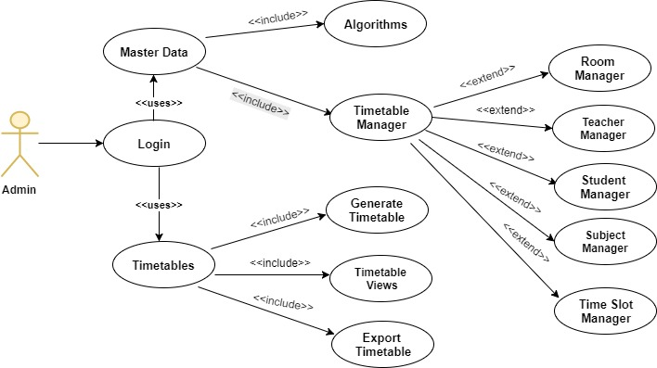
UML Diagrams
Use Case Diagrams
Admin Use Case

Slide 11
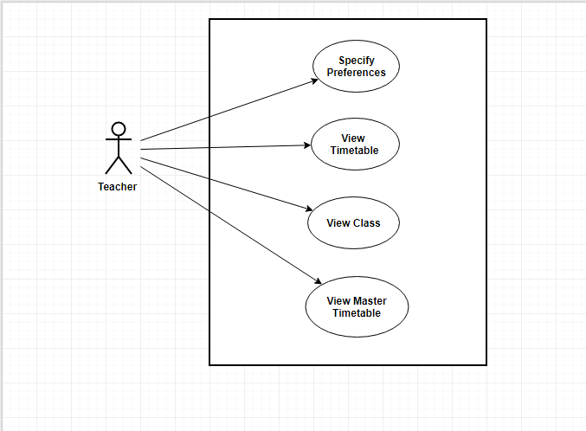
Teacher Use Case

Slide 12
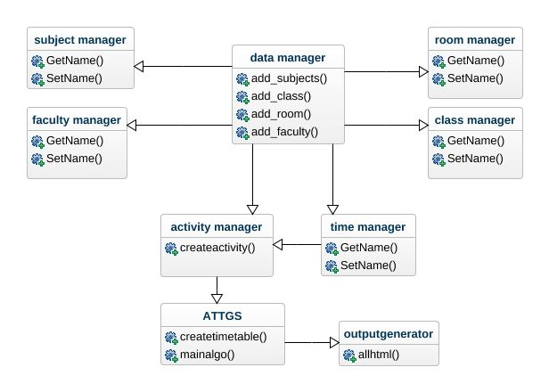
2. Class Diagram

Slide 13
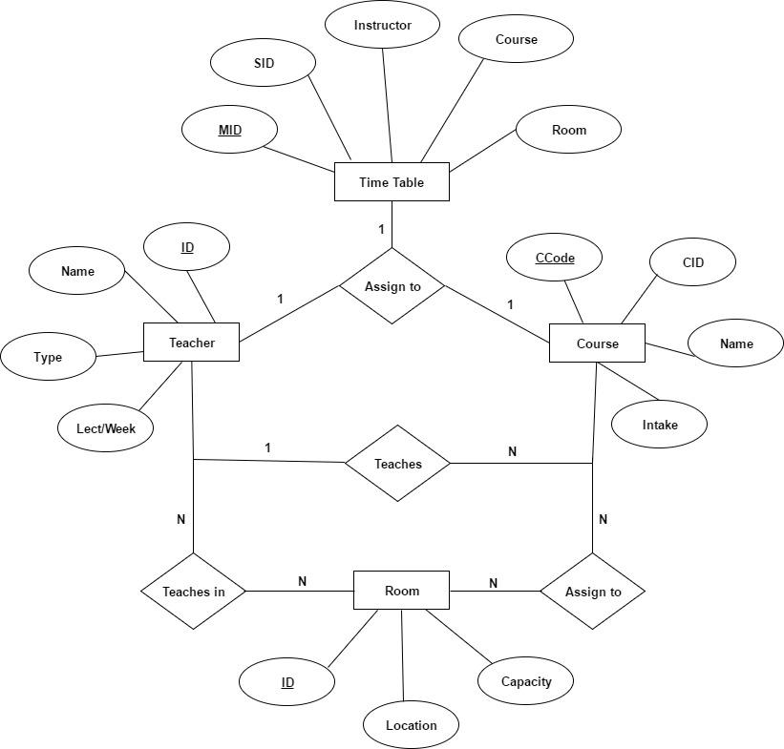
3. E-R Diagram

Slide 14
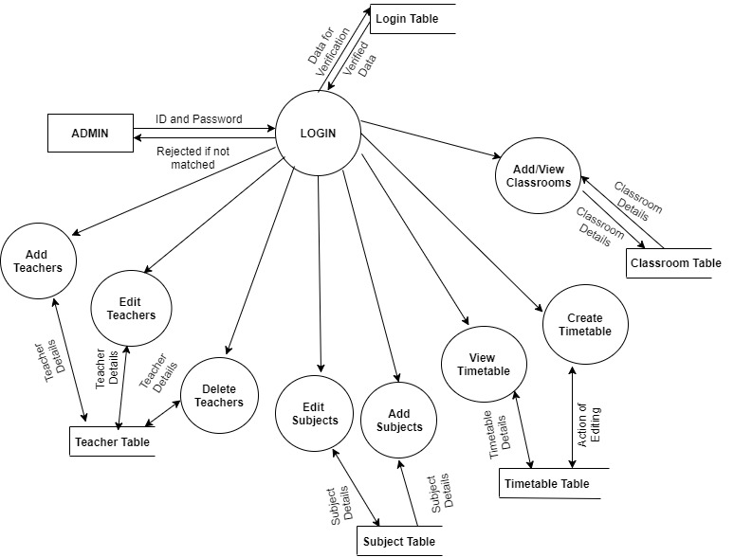
4. Data Flow Diagram (DFD)

Slide 15
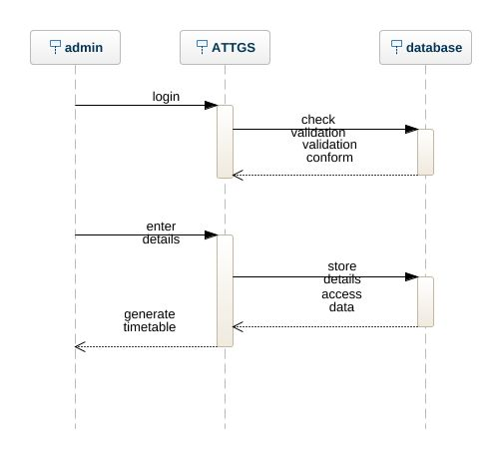
5. Sequence Diagram

Slide 16
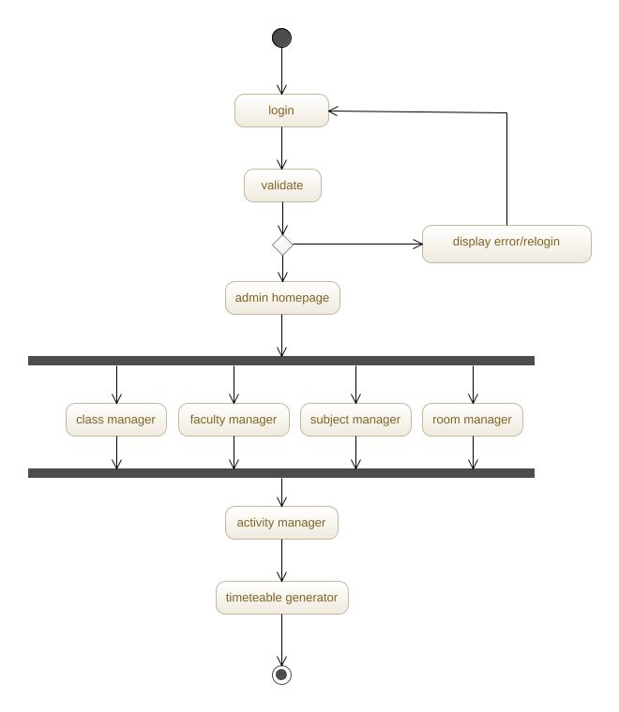
6. Activity Diagram

Slide 17
Feasibility Study
Technical Feasibility
Familiarity with Application
Familiarity with Technology
Project Size
2. Organizational Feasibility
3. Economic Feasibility

Slide 18
System Requirements
Hardware Requirements
Processor | Intel i3 or equivalent.
RAM | 2 GB(min.)
Hard Disk Space | 20GB
Software Requirements
1. MS-Visual Studio 2010
2. MS-SQL Server
3. Any Web Browser

Slide 19
Gantt Chart
Project Stage | Start Date | End date | Duration(Days)
Deciding and registering the Topic | 01-08-2017 | 10-08-2017 | 12
Working on Synopsis | 20-08-2017 | 22-08-2017 | 03
Working on SRS | 22-08-2017 | 14-09-2017 | 21
Coding/Testing | 19-09-2017 | 19-10-2017 | 28
Implementation | 26-10-2017 | 14-11-2017 | 21
Demonstration | 14-11-2017 | 16-11-2017 | 03
Report Submission | ---------------- | 16-11-2017 | 01

Slide 21
Thank you

